Slide 1
Credersi-Vend Admin Project
Notes:
AHOY!
Welcome everyone, here and remotely!

Slide 2
Housekeeping
Notes:
Welcome
We’ll be running for around 40 minutes today
Please save any questions until the end
For anyone remote or here in person, let us know about any sound, visual or technical issues at any time!

Slide 3

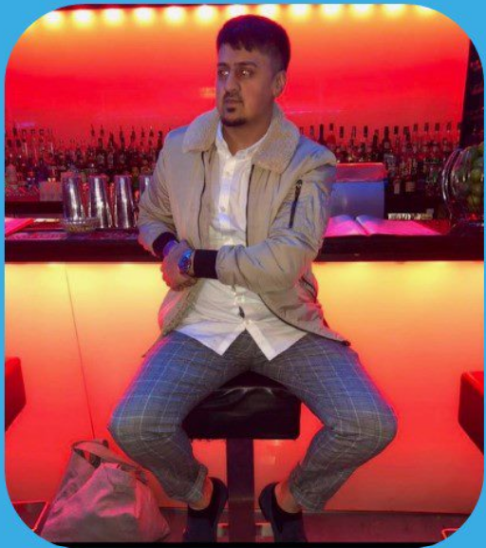
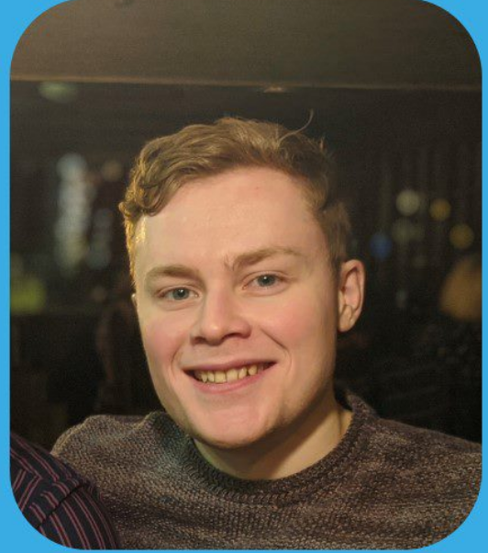
Meet the Ahoy Travel team!
Alec Riding
Avais Hussain
James Croxford
Notes:
Meet our team! I’m Avais, this is James and Alec. We are graduate testers part of the ROQ test engineering academy 2022.

Slide 4
Agenda
Introduction​ Of Product And Requirements
​Approach and Planning
Test Case Design
​Testing the levels
Bug Reports
Blockers
Summary
Notes:
[AVAIS]
Before we go into the actual presentation we would like to give you an overview of what you can expect to be covered throughout
We will start off by giving you an introduction on what the product is that we have been testing and the requirements.
Following this we will touch on the approach we took to testing and planning. There will also be an explanation of test case design and how we went about testing the levels. These four levels are: Component testing, integration testing, system testing, and acceptance testing.

Slide 5
Background
Founded in 2009, Bury St Edmunds
Supply and operate vending machines
They sell premium Suffolk products
Notes:
[AVAIS]
Credersi-Vend, vending machine company based in Bury St Edmonds
They supply and operate vending machines across the south-east
Traditional paper based admin company
They want to develop internal applications to digitize their work processes
Credersi-Vend Admin is their first attempt at this

Slide 6
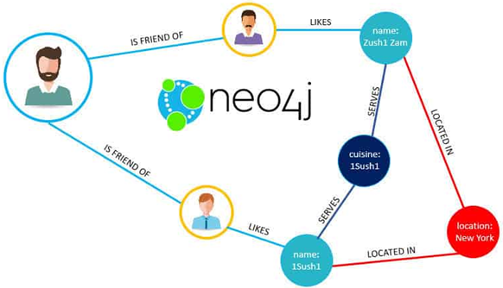
Introduction
Web based Application
Which users can use to manage vending machines.
Hosting a database, using NEO4J.
The main functions of the application are:
Login
Create Customer Companies
Create Sites
Create Machines
Notes:
The credersi-vend admin application is a web-based application.
The purpose of this is to allow Credersi engineers easier access to locating different vending machines at different customer sites and aid in the management of these machines.
The web application also consists of a database that is hosted using neo4j. We have identified the application to have 4 main functions.
These are: the login function, the create customer function, create sites function, and the create machine function.

Slide 7
Credersi Vend Admin
DEMO HERE

Slide 8
Objectives
OBJECTIVE: to provide sufficient evidence to evaluate levels of confidence in the quality of the software
Minimum viable product
Test the application
Find defects to prevent failures
Document bugs
Notes:
Read out overall objective:
The owner of Credersi-Vend is non-technical
Sought independent testers to evaluate an internal alpha build of Credersi-Vend Admin
Trying to determine if it is at present a minimum viable product
We aim to verify against the product requirements, and validate that the right product is being produced
We hope to find defects now to evaluate the software to prevent failures in the future!

Slide 9
Approach and planning

Slide 10
Approach & planning
Test Plan
We decided to create a test plan before we actually kicked off the project so everybody is aware of what is needed to be done.
Test Strategy
We decided to put in place a test strategy that encompesses guidelines and principles involved in testing process
Notes:
INSERT SCREENSHOT SLIDES OF TEST PLAN & STRATEGY

Slide 11
Approach & planning
Outcomes
Used documents to identify
Areas of high defect risk
Knowledge gaps/Experience
Time constraints
Contingency plans
Team availability

Slide 12
PROPOSED WEEkLY PLANNER- WEEK 1
Week 1 | MONDAY 5/09/2022 | TUESDAY 6/09/2022 | WEDNESDAY 7/09/2022 | THURSDAY 8/09/2022 | FRIDAY 9/09/2022
8:45:9:00 | Standup With Everyone | Standup With Everyone | Standup With Everyone | Standup With Everyone | Standup With Everyone
09:00 - 10:45 | Set Up Our Workspace | Created Trello Board | Test Strategy | Document Review | Test Designs
11:00 – 12:00 | Set Up Environment & Forked Work | Test Plan | Test Strategy | Document Review | Test Cases
12:00 - 13:00 | ✔ Free Time | ✔ Free time | ✔ Free Time | ✔ Free Time | ✔ Free Time
13:00 - 14:00 | Set Up Environment & Forked Work | Test Plan | Test Strategy | Gant Chart | Test Cases
14:00 - 15:45 | Set Up Environment & Forked Work | Test Plan | Test Strategy | User Stories Review | Test Cases
15:00 - 16:30 | Created Trello Board | Test Plan | User Stories | Test Designs | Test Cases

Slide 13
PROPOSED WEEkLY PLANNER- WEEK 2
Week 2 | MONDAY 12/09/2022 | TUESDAY 13/09/2022 | WEDNESDAY 14/09/2022 | THURSDAY 15/09/2022 | FRIDAY 16/09/2022
8:45:9:00 | Standup With Everyone | Standup With Everyone | Standup With Everyone | Standup With Everyone | Standup With Everyone
10:00 - 10:45 | User Acceptance/System | User Acceptance/System | Documentation For Defects | Commit Github | Preparation
11:00 - 11:45 | User Acceptance/System | User Acceptance/System | Documentation For Defect | Feedback | Preparation
12:00 - 13:15 | ✔ Free Time | ✔ Free Time | ✔ Free Time | ✔ Free Time | ✔ Free Time
13:30 - 14:15 | User Acceptance/System | User Acceptance/System | Presentation | Reflection | Presentation
14:30 - 15:15 | User Acceptance/System | User Acceptance/System | Presentation | Reflection | Presentation
15:30 - 16:15 | User Acceptance/System | User Acceptance/System | Commit Github | Reflection | Presentation

Slide 14
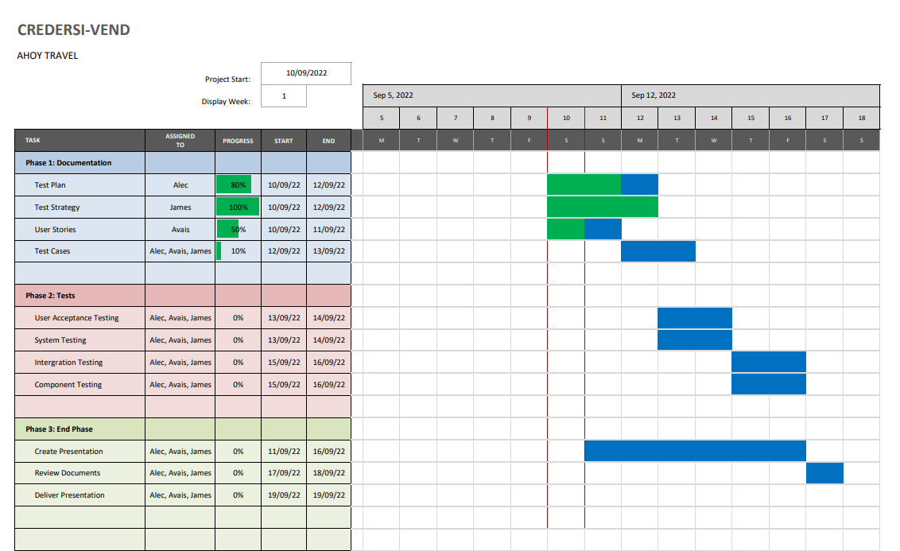
GANTT CHART
Notes:
Used to weekly plans to form a Gantt Chart as seen
Set out timescales for each part of our planned works
UPDATE PICTURE

Slide 15
Notion Slide placeholder

Slide 16
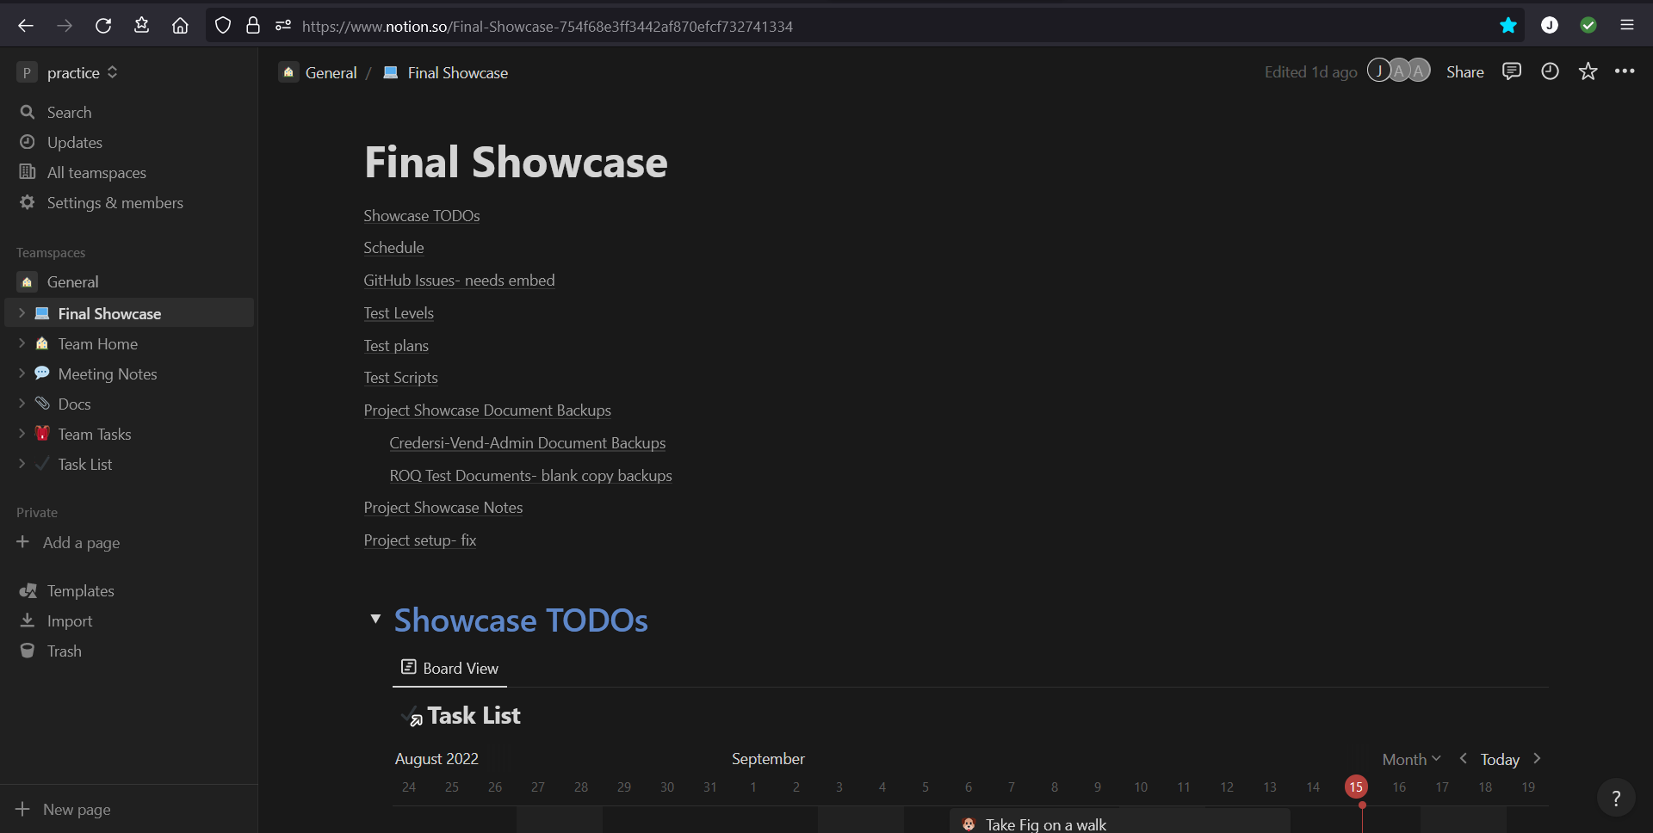
GANTT CHART
Notes:
JAMES- sort this crap

Slide 17
Test Case Design

Slide 18
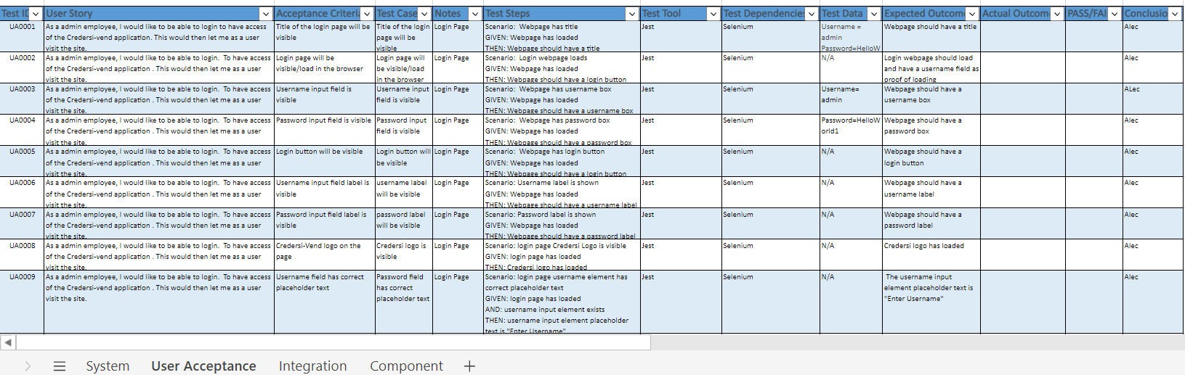
Test Case Design
Notes:
We created an excel spreadsheet that consisted of user stories, test cases, acceptance criteria, outcomes, etc for all 4 different test levels.
This was used to help keep track of the user stories that were created and the test cases linked to them.
This also helped the process of scripting tests as it meant we could easily understand how to go about automating the test cases.
This spreadsheet was updated by all members of our team which meant that it was constantly being changed and new information added to it.
We felt that this was a great way to keep track of all the important information and test data as it is displayed in a clear and concise way.

Slide 19
Test Case Documentation Feedback
Notes:
Based on a peer review discussion, advice given to split the document we had produced into three explicit documentation
The first covered Test Designs
The second Test Procedures and processes
The last covered Test Execution and results
INSERT SCREEN SHOTS

Slide 20
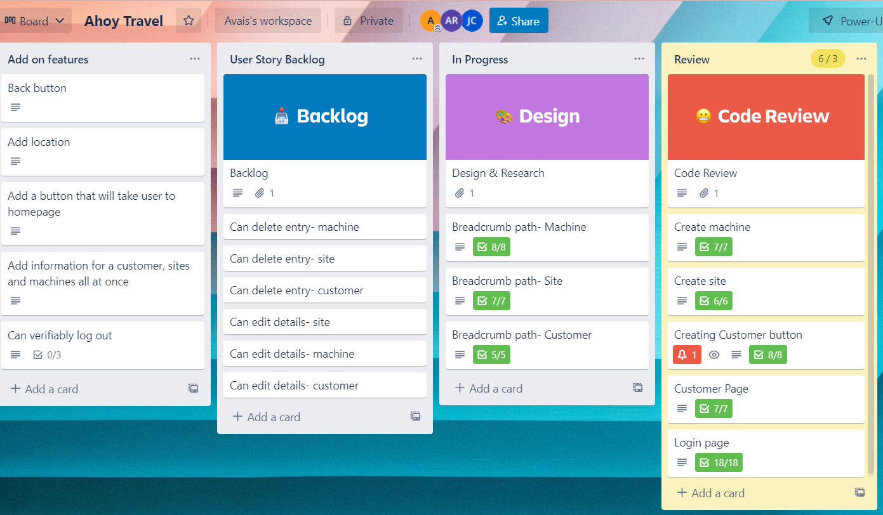
Trello Board
Notes:
Per discussions with the developer team, we created a Trello board which mirrored their progress through user stories for Credersi Vend Admin
All stories match up to the developer’s own
We used these stories and their acceptance criteria to help form our test basis, and to aid us in creating test cases
Note that there numerous outstanding user stories being worked upon
And several more identified for future developer sprint cycles

Slide 21
Credersi Vend Admin

Slide 22
Neo4J Database
Java Backend running on Sprint Boot
Svelte framework frontend (HTML, CSS & JavaScript)
Routes Component? CHECK NOTES

Slide 23
Testing The Levels

Slide 24
Four Levels
Component
Integration
System
Acceptance
Notes:
Before the release of an application, it undergoes a thorough testing process in an attempt to ensure that the application is working in the way it was intended to do so.
To enhance the quality of software testing, the process of testing can be abstracted into different levels.
These are known as the levels of testing and there are four main ones. So, what are these?
The first is component testing, this is followed by integration testing, which leads to system testing and finally, acceptance testing. Each of these levels have a specific purpose.
In this project there were three main components (frontend, backend, and routes) all of which had to be integrated to become one system that is accepted by the client.

Slide 25
Test level we did in order
Acceptance
System
Integration
Component
Notes:
Did it this way due to experience and what we felt comfortable doing
Wanted to priorities the parts that we felt more confident it so we could complete a good amount of work to present

Slide 26
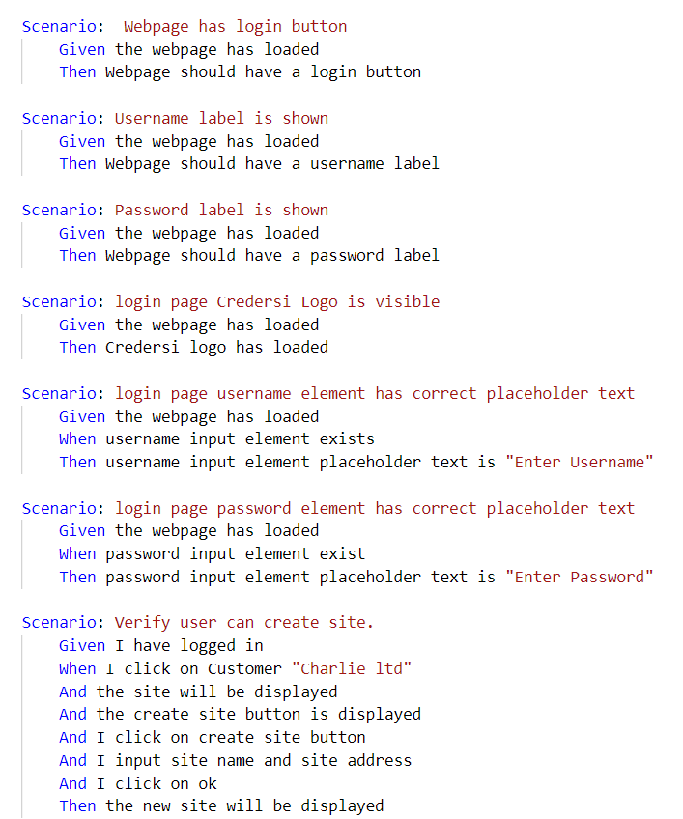
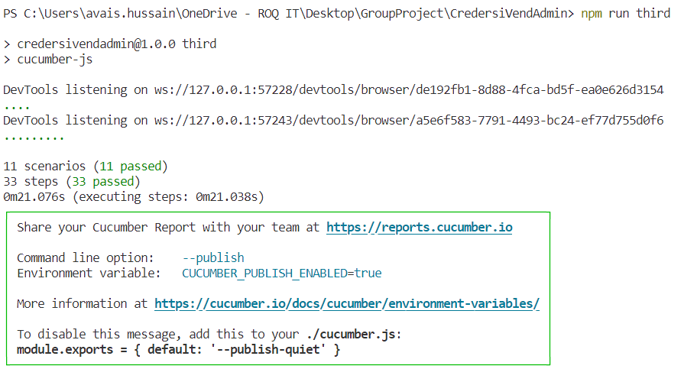
Acceptance Testing

Slide 27
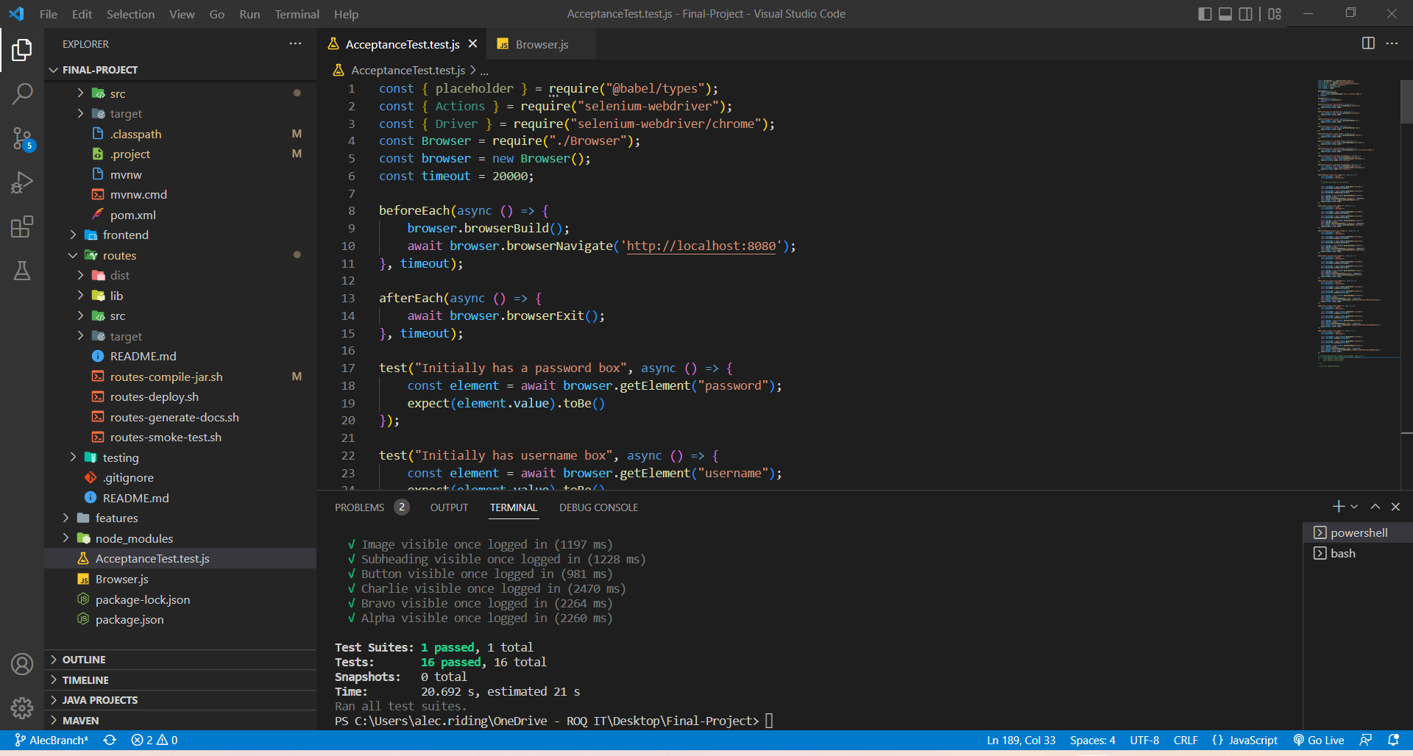
System Testing

Slide 28
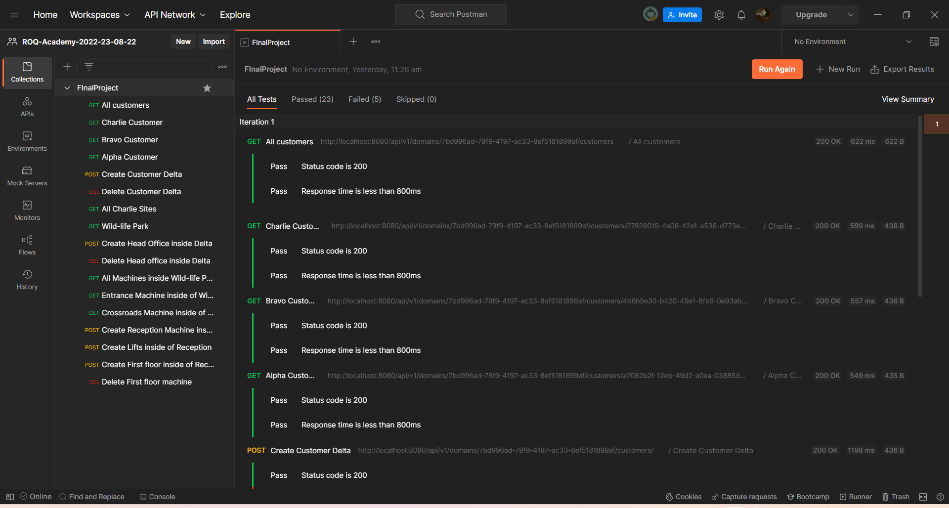
Integration Testing

Slide 29
Component Testing

Slide 30
Defects

Slide 31
Bug report

Slide 32
Conclusions on Credersi Vend Admin

Slide 33
Exhausive Testing is impossible !
The absence of errors fallacy !

Slide 34
Reflections

Slide 35
89,526,124
Whoa! That’s a big number, aren’t you proud?

Slide 36
Blockers
Set up environment
Setting up framework
Inexperience team
Debugging

Slide 37
LET’S REVIEW SOME CONCEPTS
Yellow
Is the color of gold, butter and ripe lemons. In the spectrum of visible light, yellow is found between green and orange.
Blue
Is the colour of the clear sky and the deep sea. It is located between violet and green on the optical spectrum.
Red
Is the color of blood, and because of this it has historically been associated with sacrifice, danger and courage.
Yellow
Is the color of gold, butter and ripe lemons. In the spectrum of visible light, yellow is found between green and orange.
Blue
Is the colour of the clear sky and the deep sea. It is located between violet and green on the optical spectrum.
Red
Is the color of blood, and because of this it has historically been associated with sacrifice, danger and courage.

Slide 38
CREDITS
Special thanks to all the people who helped and supported us during the project:
Laurence Martin (Floz)
Madeline Harrop
Steven Knowles
Amira and Andy

Slide 39

THANKS FOR KINDLY LISTENING!
Any questions?

